Slide 1
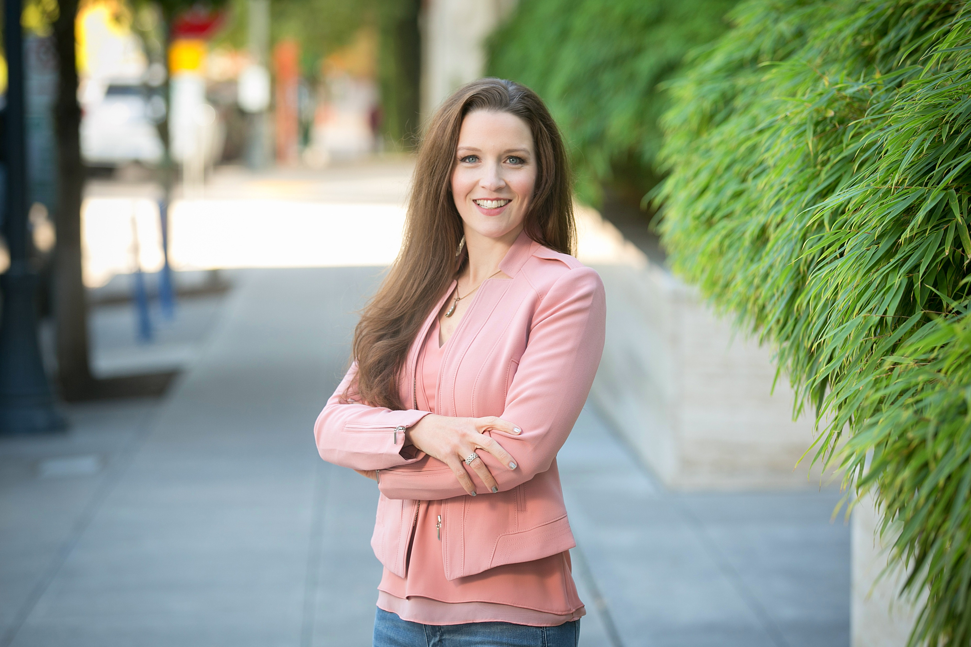
Jennifer Saliba, President
Rhino Consulting
jennifer@consultrhino.com
PROUD SPEAKER

Slide 2
First Last, Title
Company
email@domain.com
PROUD SPEAKER

